Slide 1
Simple Plot
Benjamin Dragenice CTEC 298

Slide 2
Simple Plot Discussion
The purpose of plotting data is to show a visualization of the relation between the data set.
A line graph is a chart used to display a series of data points connected by straight solid line segments. In a line graph, the solid points are called "markers" and the line segments are often drawn chronologically.

Slide 3
When would a simple plot be used
To determine relationships between two different things. The x-axis is used to measure one even and the y-axis is used to measure the other.
Also used to track changes over short and long periods of time.

Slide 4
Simple Plot Python Code
import matplotlib
import matplotlib.pyplot as plt
import numpy as np
# Data for plotting
t = np.arange(0.0, 2.0, 0.01)
s = 1 + np.sin(2 * np.pi * t)
fig, ax = plt.subplots()
ax.plot(t, s)
ax.set(xlabel='time (s)', ylabel='voltage (mV)',
title=‘Simple Plot')
ax.grid()
fig.savefig(“simpleplot.png")
plt.show()

Slide 5
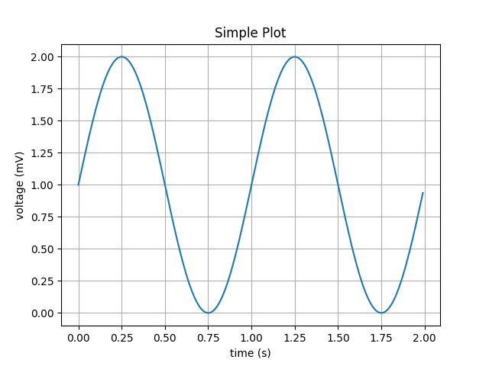
Simple Plot Graphic

Slide 6
References
Matplotlib.pyplot.plot¶. (n.d.). Retrieved February 25, 2021, from https://matplotlib.org/devdocs/api/_as_gen/matplotlib.pyplot.plot.html#matplotlib.pyplot.plot
Simple plot¶. (n.d.). Retrieved February 25, 2021, from https://matplotlib.org/devdocs/gallery/lines_bars_and_markers/simple_plot.html
Line graph - when to use it? (n.d.). Retrieved February 25, 2021, from https://www.edrawsoft.com/chart/when-to-use-line-graph.html
https://www.youtube.com/watch?v=SiCyTcudoSE - Python Tutorial : Basic plots with python matplotlib

